Slide 1
Types of Attacks
Lecture 3

Slide 2
‘Attack’ in Cyber and Information Security
An attack refers to an intentional or malicious act that aims to compromise the confidentiality, integrity, or availability of information or information systems.
It is the process of attempting to steal data or gaining unauthorized access to computers and networks using one or more computers.
Attacks = Motive (Goal) + Vulnerability + Method

Slide 3
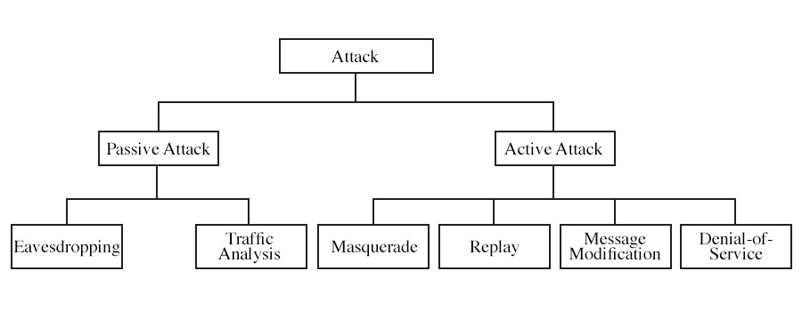
Types of Attack

Slide 4
Passive Attack
Passive attacks, on the other hand, focus on unauthorized monitoring or capturing of data without altering it, like eavesdropping or sniffing network traffic.
Types of passive attacks are as follows:
The release of message content
Traffic analysis

Slide 5
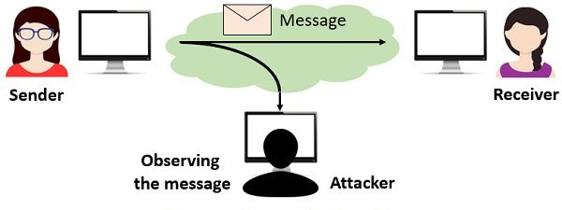
Passive Attack (Release of message content)
A telephone conversation, an electronic mail message, and a transferred file may contain sensitive or confidential information.
In this type of attack, the attacker secretly listens to a conversation or communication that is not intended for him.
It can be done for various purposes, such as gathering information, spying, or blackmailing.
Release of message content

Slide 6
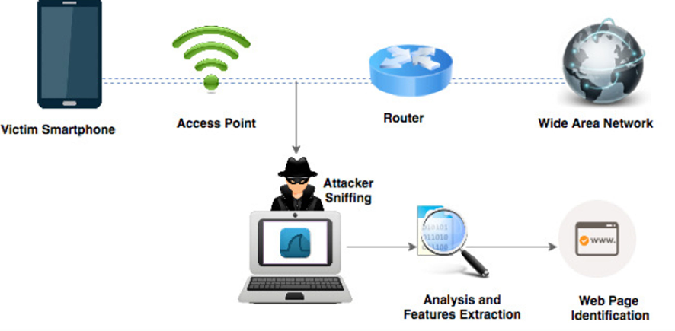
Passive Attack (Traffic analysis)
Traffic analysis is a passive attack that focuses on observing the exchange of information between two entities to extract valuable information. Even the encrypted data can be used by attackers to discover the geographical location and the identities of the communicating entities, along with details regarding the frequency and duration of the exchanged messages. This information is valuable in determining the nature of the ongoing communication.
Traffic analysis

Slide 7
Active Attack
An active attack involves direct interference or manipulation of data or systems, such as modifying or deleting data, launching Denial of Service (DoS) attacks, or injecting malware.
A few common types of active attacks are
Masquerade
Modification of messages
Replay
Denial of Service

Slide 8
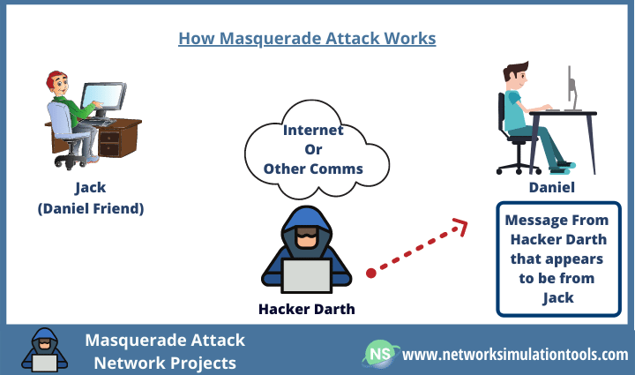
Active Attack (Masquerade)
A masquerade attack is a type of active cyberattack that happens when an attacker impersonates a legitimate user or system to gain access to sensitive information.
Hackers may use stolen credentials, user identifiers, fake identities, or malicious software to trick security mechanisms and individuals and bypass authentication processes.
These attacks can have severe consequences, including data breaches, financial loss, and security risks.
Masquerade Attack

Slide 9
Active Attack (Masquerade)
Masquerade attacks can take various forms, including:
User masquerade: An attacker gains access to valid user credentials (e.g., username and password) through various means, such as phishing, social engineering, or password cracking. They then use these credentials to impersonate the legitimate user and gain unauthorized access to systems or data.
Device masquerade: In this scenario, the attacker pretends to be a trusted device on a network to exploit the trust relationship between devices. For example, an attacker might use the MAC address or IP address of a trusted device to gain access to the network and launch further attacks.
Website masquerade: Here, the attacker creates a fake website that closely resembles a legitimate one to trick users into providing sensitive information like login credentials, credit card details, or personal information.
Application masquerade: In this case, the attacker creates a malicious application that appears legitimate, tricking users into installing it on their devices. Once installed, the application may perform malicious actions or steal sensitive data.
System masquerade: The attacker disguises their system or network as a trusted one to intercept or redirect network traffic or launch attacks on other systems, exploiting the trust established between systems.

Slide 10
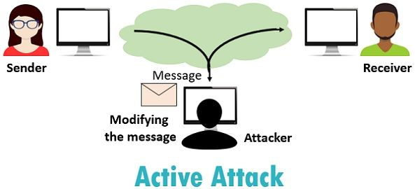
Active Attack (Modification of message )
It simply means that some portion of an authorized message is altered, or that messages are delayed or reordered, to produce an unauthorized effect.
For example, a message meaning "Allow Alice to read confidential file accounts" is changed to "Allow Bob to read confidential file accounts."
Modification of Message

Slide 11
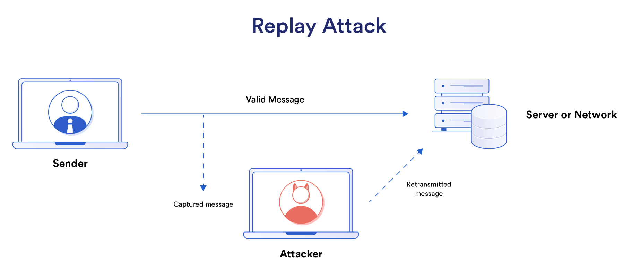
Active Attack (Replay)
It is a passive capturing of a message with an objective to transmit it for the production of an authorized effect.
Thus, in this type of attack, the main objective of an attacker is saving a copy of the data that was originally present on that particular network and later on using it for personal uses. Once the data gets corrupted or leaked, it becomes an insecure and unsafe tool for its users.
From online banking transactions to keyless car entry, replay attacks are a security concern whenever an authenticated message authorizes a specific action. This action can be unlocking a car, sending a banking transaction, or any other number of security-sensitive actions.

Slide 12
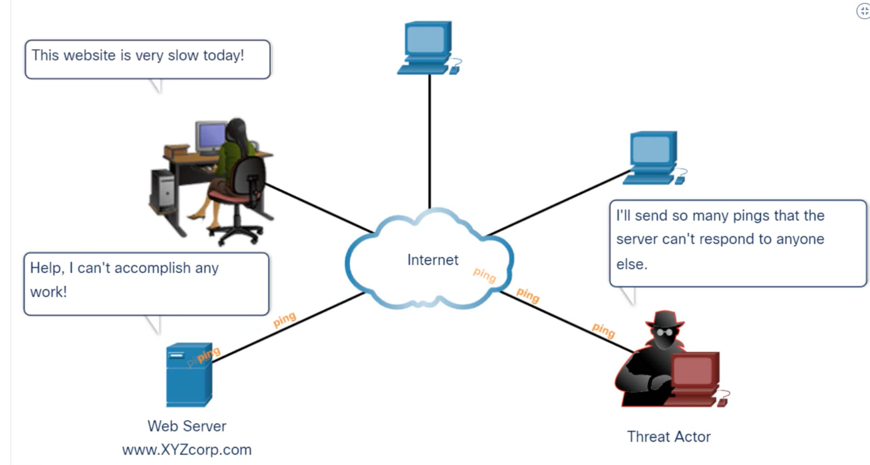
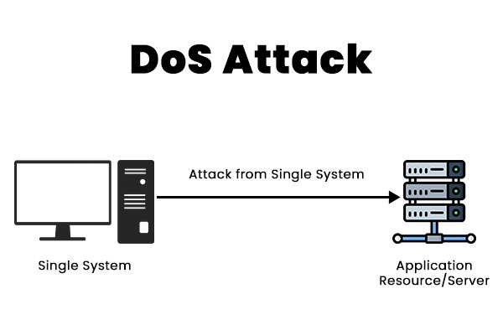
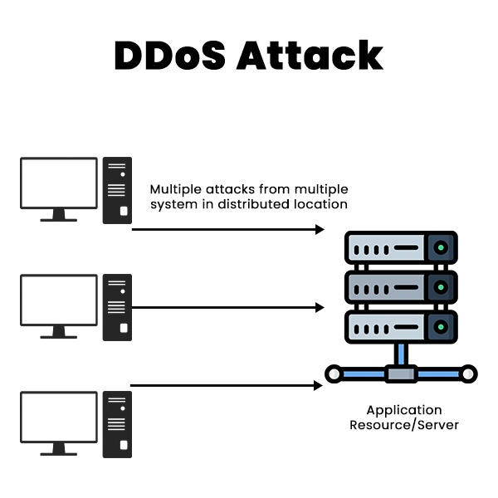
Active Attack (Denial of Service)
Denial of Service (DoS) is a cyberattack on an individual computer or website with the intent to deny services to intended users.
In this type of attack, the attacker floods the system with fake requests or data in order to make a service, website, or server unavailable.
Their purpose is to disrupt an organization's network operations by denying access to its users. For example, if a bank website can handle 10 people a second by clicking the Login button, an attacker only has to send 10 fake requests per second to make it so no legitimate users can log in.

Slide 13
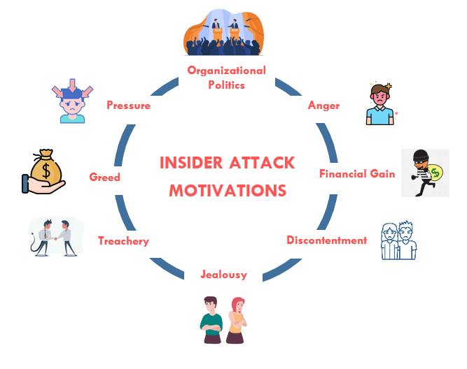
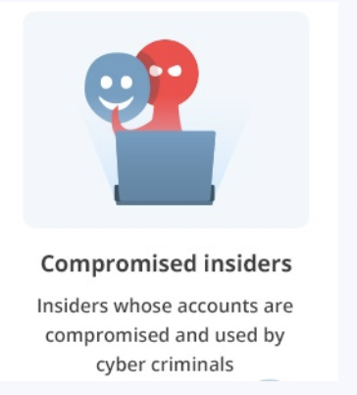
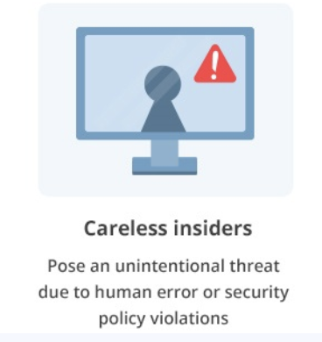
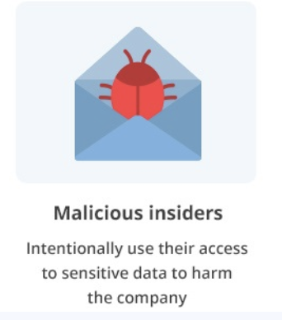
Insider Attack
Insider attacks involve individuals who have authorized access to systems or information but misuse their privileges for malicious purposes.

Slide 14
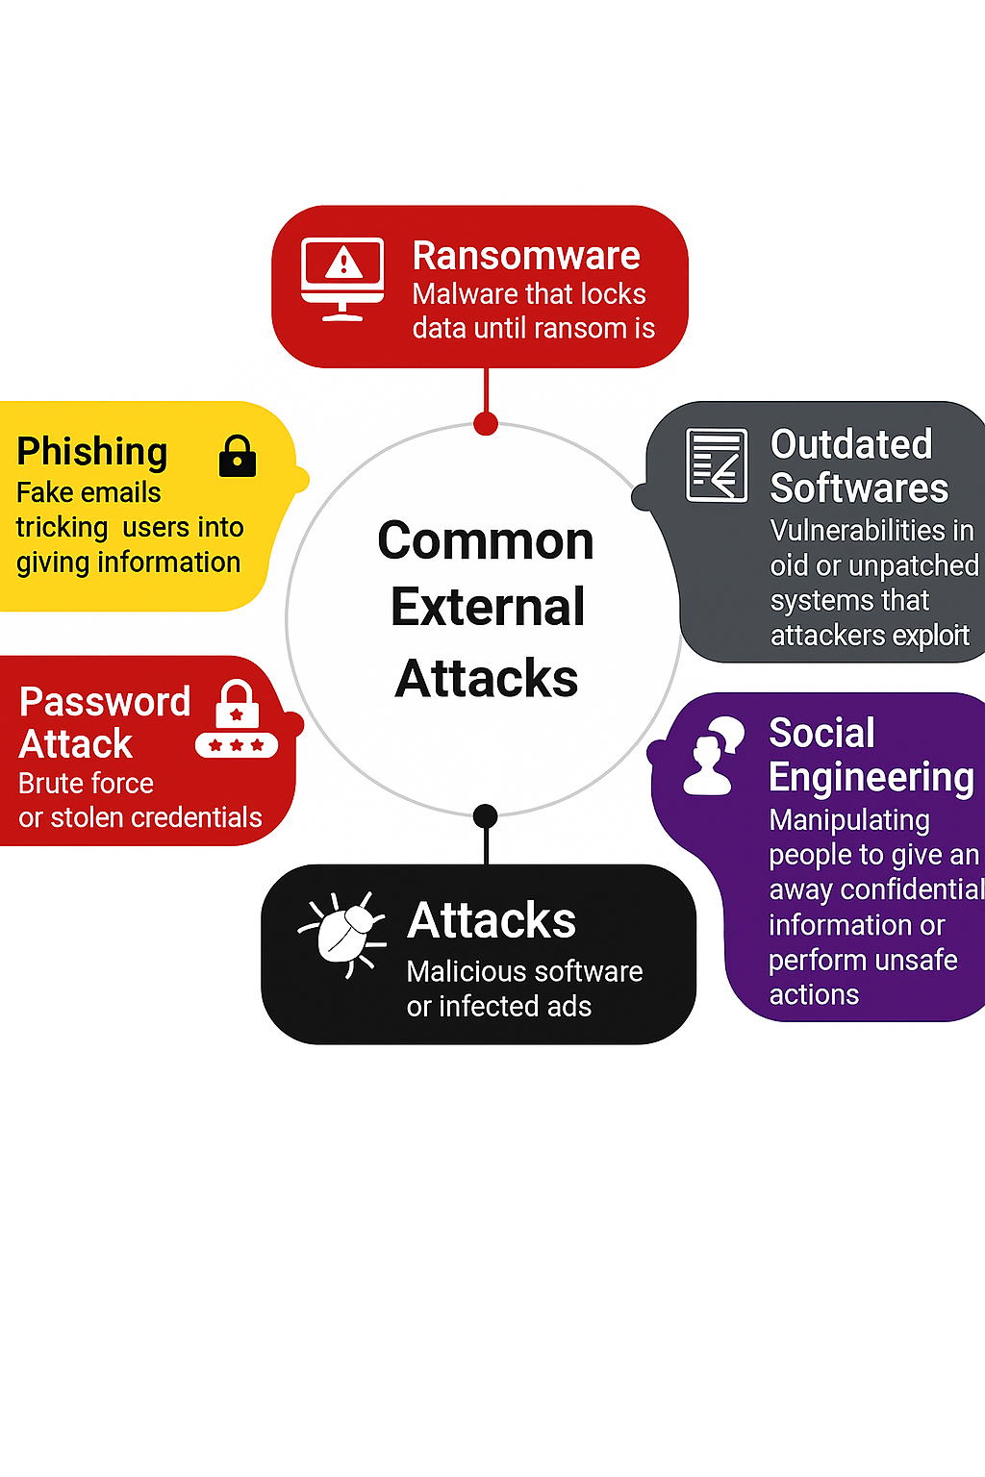
External Attacks
External attacks are conducted by individuals or groups who do not have authorized access and typically target systems from outside the organization's network.

Slide 15
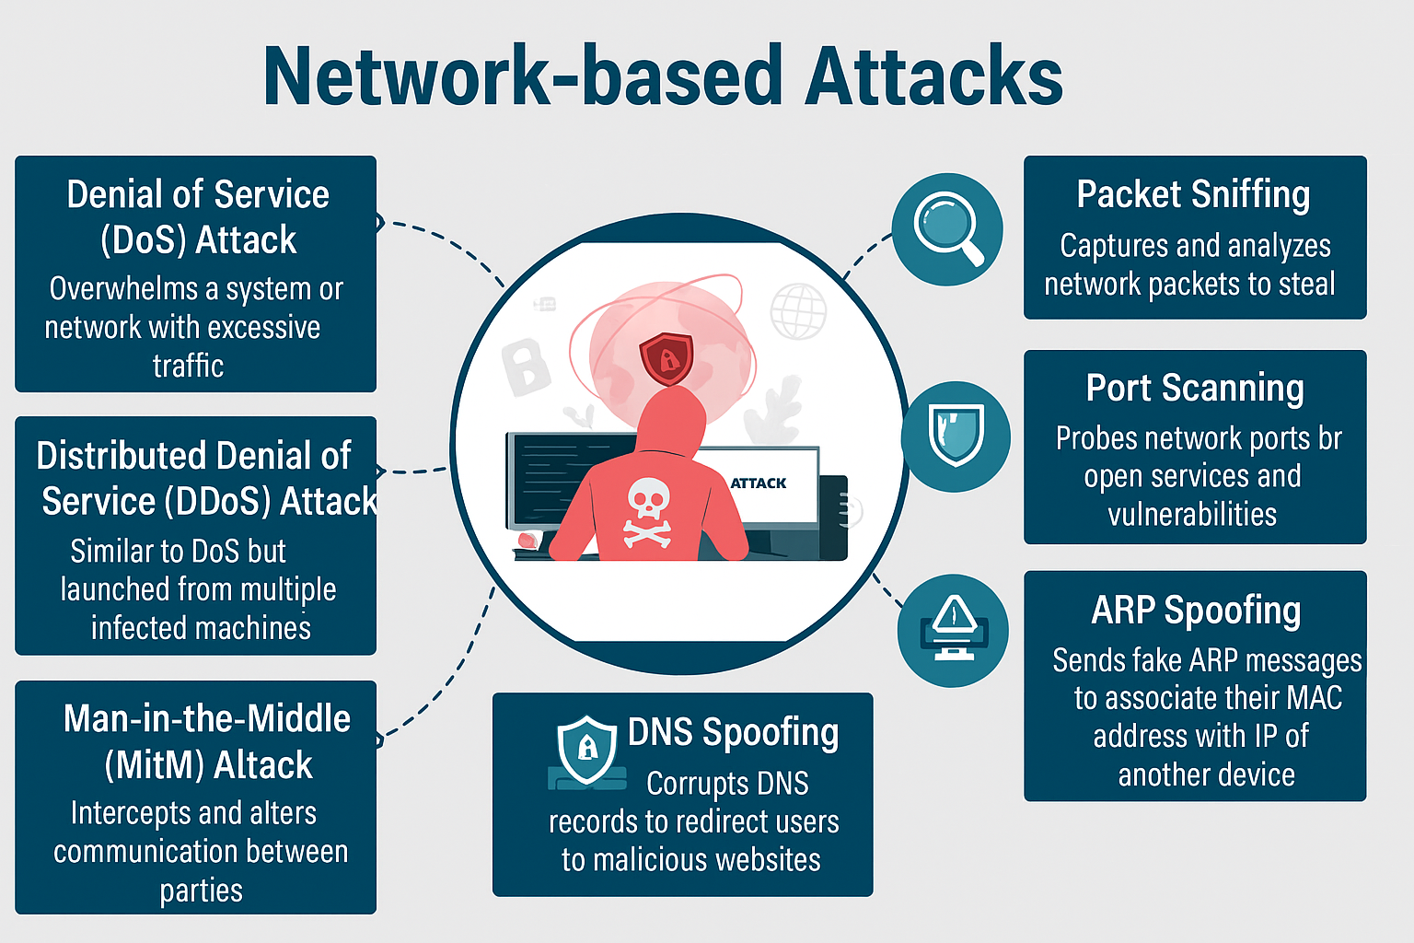
Network-based attacks
Network-based attacks target vulnerabilities in network infrastructure, protocols, or services, aiming to gain unauthorized access, disrupt communication, or intercept data.

Slide 16
Host-based attacks
Host-based attacks focus on exploiting vulnerabilities in individual computer systems or software applications, attempting to gain control over the host or compromise its data.
Types of Host-Based Attacks
Virus
Worm
Trojan Horses
Back Door
Trap Door
Symptoms:
Virus - Freezing, Slow performance, crashing
Worm - Unexpected restarts, error pop-ups, program malfunctions
Trojan Horses - Mouse moves by itself, volume goes up and down by itself

Slide 17
Thank You

